Slide 1
Valuation: Revealed preferences
Principles
Defensive expenditure
Travel costs
Zonal models
Random utility models
Hedonic pricing

Slide 2
0 Introduction
1 Social choice
2 Externalities and public goods
3 Decision analysis
4 Valuation: Aims and purpose
5 Valuation: Revealed preferences
6 Valuation: Stated preferences
7 Direct regulation
8 Market-based instruments
9 Complications with instruments
10 Growth and the environment
11 Green accounting

Slide 3
Valuation: Revealed preferences
Principles
Defensive expenditure
Travel costs
Zonal models
Random utility models
Hedonic pricing

Slide 4
Revealed Preference (RP) methods
Infer preferences for environmental goods by analysing behaviour in real, related (‘surrogate’) markets
Notes:
So, first: what are RP methods?

Slide 5
3 kinds of
surrogate markets
Notes:
3 kinds of related markets we can use…

Slide 6


Substitutes
e
m
Utility derived from or
£
clean water
bottled water
Defensive expenditure, avertive behaviour
Notes:
1
markets in substitutes

Slide 7
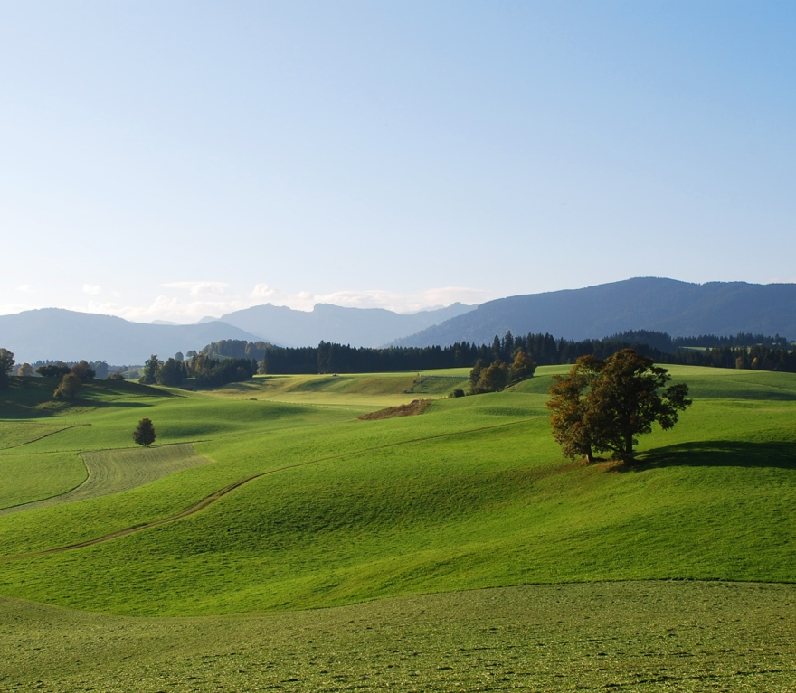
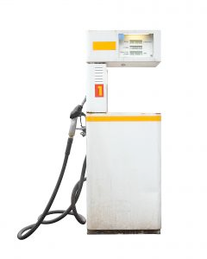
Complements
e
m
Utility derived from and
£
scenic areas
petrol
Travel cost model, incl. random utility model
Notes:
2
markets in complements
(Look at these in some detail).

Slide 8
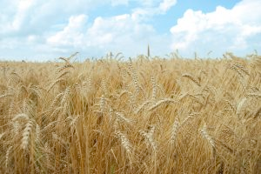
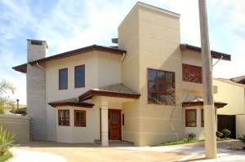
Bundles
e
m
Utility derived from as an attribute of
£
peace & quiet
a house
Hedonic pricing, hedonic wage
Notes:
3
markets in characteristics
… ideally these are brought together.

Slide 9
Revealed Preferences: general strengths
Based on real economic behaviour
No survey biases or strategic response
Cost-effective
Don’t always need original survey data
Surveys, if needed, may be less complex than for stated preferences

Slide 10
Revealed Preferences: general weaknesses
Consumptive/extractive
Direct
Use values only
Market imperfections?
WTP for non-marginal changes?
Hedonic pricing studies especially
Use values
Non-consumptive
Indirect
Total Economic Value (TEV)
Option value
Option values
Quasi-option value
Bequest
Others’ use
Non-use values
Altruism
Pure existence

Slide 11
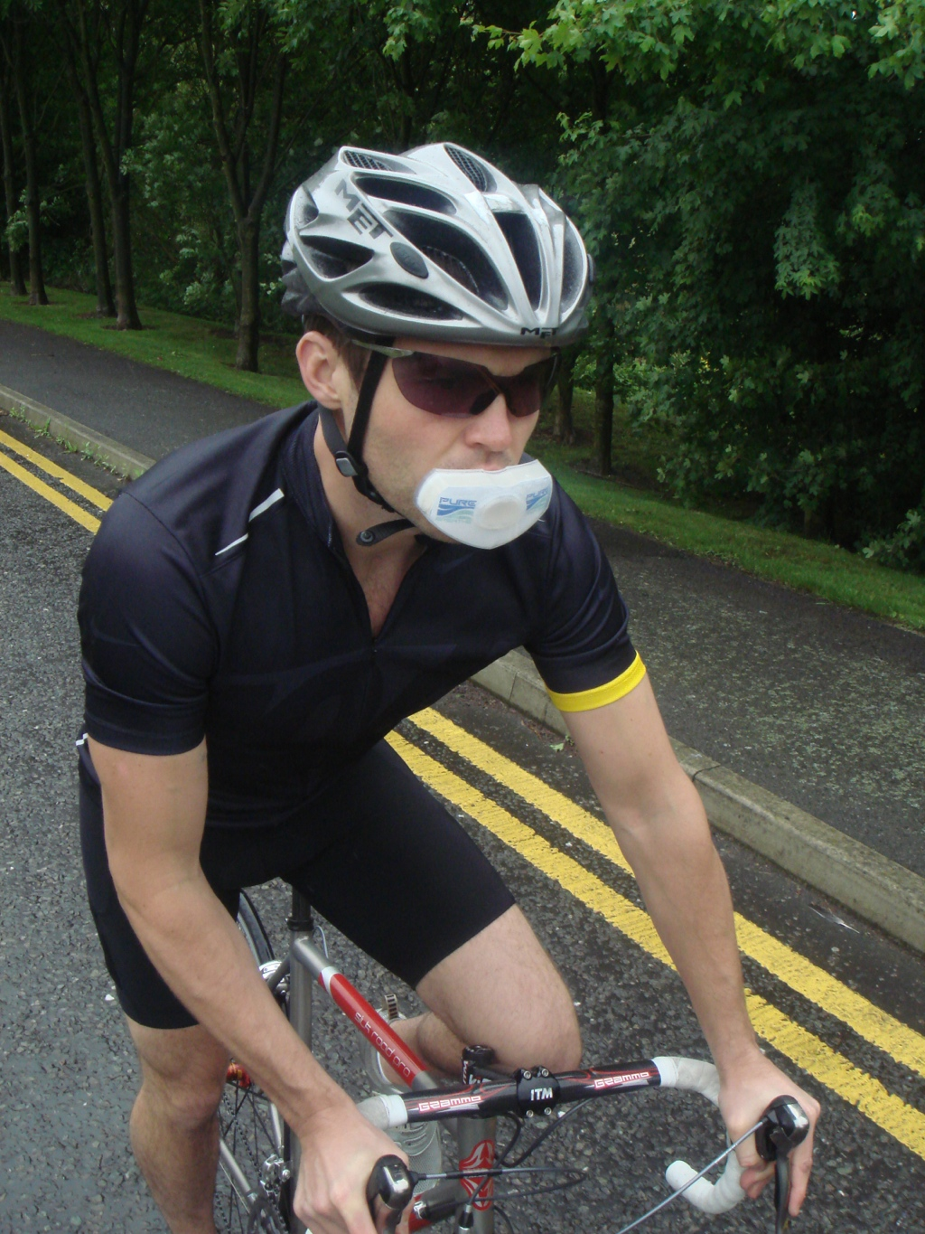
Valuation: Revealed preferences
Principles
Defensive expenditure
Travel costs
Zonal models
Random utility models
Hedonic pricing

Slide 12
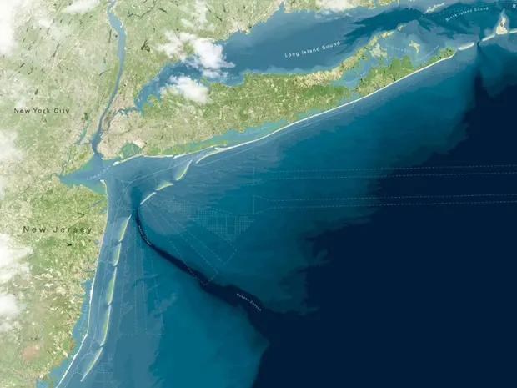
Defensive expenditure: overview
Replacement costs
Avoided costs
Notes:
Thinking behind defensive expenditure is simple:
if people spend £5000 on double glazing purely to mitigate noise,
then they must anticipate that the noise will cost them at least £5000 in welfare.
So spending on dbl glazing is a lower bound on the value of the noise.

Slide 13

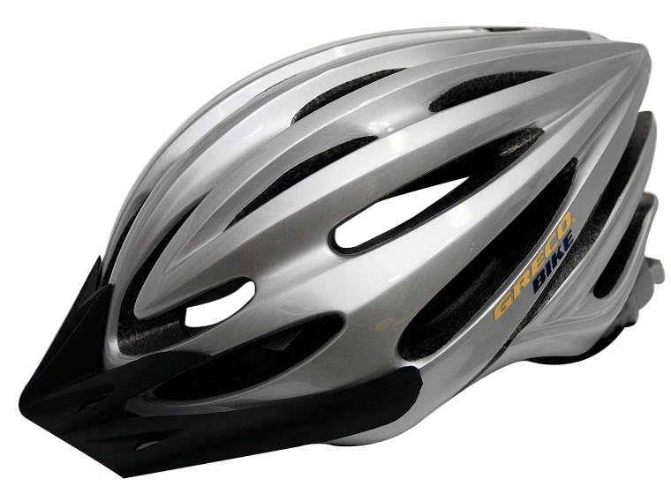
Defensive expenditure: overview
Replacement costs
Avoided costs
Defensive expenditure
Costs incurred in attempting to mitigate or prevent damage
Bottled water — mitigates risk of illness
Double glazing — mitigates noise
Cycle helmet — mitigates risk of injury/death (⇒ VoSL)
Notes:
Thinking behind defensive expenditure is simple:
if people spend £5000 on double glazing purely to mitigate noise,
then they must anticipate that the noise will cost them at least £5000 in welfare.
So spending on dbl glazing is a lower bound on the value of the noise.

Slide 14

Case study 1:
water quality

Slide 15
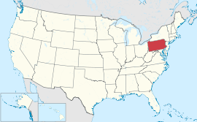
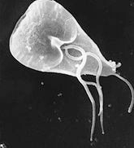
Defensive expenditure: case study
Milesburg, Pennsylvania, 1989
Laughland et al., 1993
Giardia contamination of water supply
Intestinal parasite causes diarrhoea, fever, cramps, nausea
What was welfare loss?
So, conversely: what’s the value of a clean, drinkable water supply?
$$$
Notes:
…
How much welfare was lost as a result of this?
Provides a guideline to policymakers (or water companies) on how much it’s worth spending to prevent?
(Though in fact private cost of lost reputation might be a lot bigger).

Slide 16
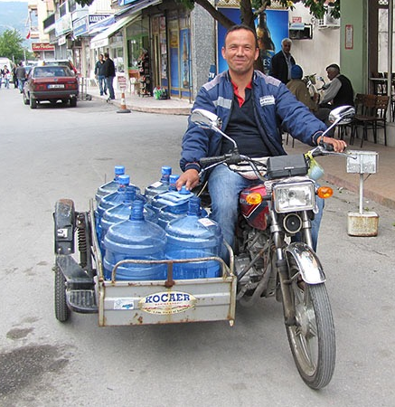

Case study: methods
Surveyed residents: what did they do?
Boiled, filtered, purchased, hauled — or did nothing
Analysis: what did it cost?
Purchases + energy + fuel + opportunity cost of time
Results heavily dependent on opportunity cost of time
Notes:
…
Purchases: bottled water, filters, etc.
Energy: electricity or gas to boil water
Fuel: petrol or diesel for the journey to fetch water
How do you value people’s time?

Slide 17
Case study: results
 | Assumed value of time
 | Midpoint of range of household incomes | Minimum wage | Zero
Total cost, all 478 households, Jan – Apr | US$45,000 | US$18,000 | US$8,000
Notes:
$45k = c. $30/hh/month
What about the did-nothings?
No cases of giardiasis were reported. But if anyone actually got giardiasis, one would expect that to add a lot to the values (medical bills, legal action, WTP not to be ill, etc.)

Slide 18
Defensive expenditure: limitations
Mitigation generally incomplete
e.g. double glazing isn’t perfect (no use in the garden, or if windows open)
Might have been willing to pay more than it costs
Hard to identify all defensive behaviours
e.g. boil water and/or buy filter and/or buy water and/or switch to beer and/or …
Including non-market responses
e.g. water: doing less exercise and drinking less
e.g. air pollution: staying indoors
Mitigation may have joint products
e.g. double glazing also produces energy conservation
e.g. bottled water (or beer) may taste better

Slide 19
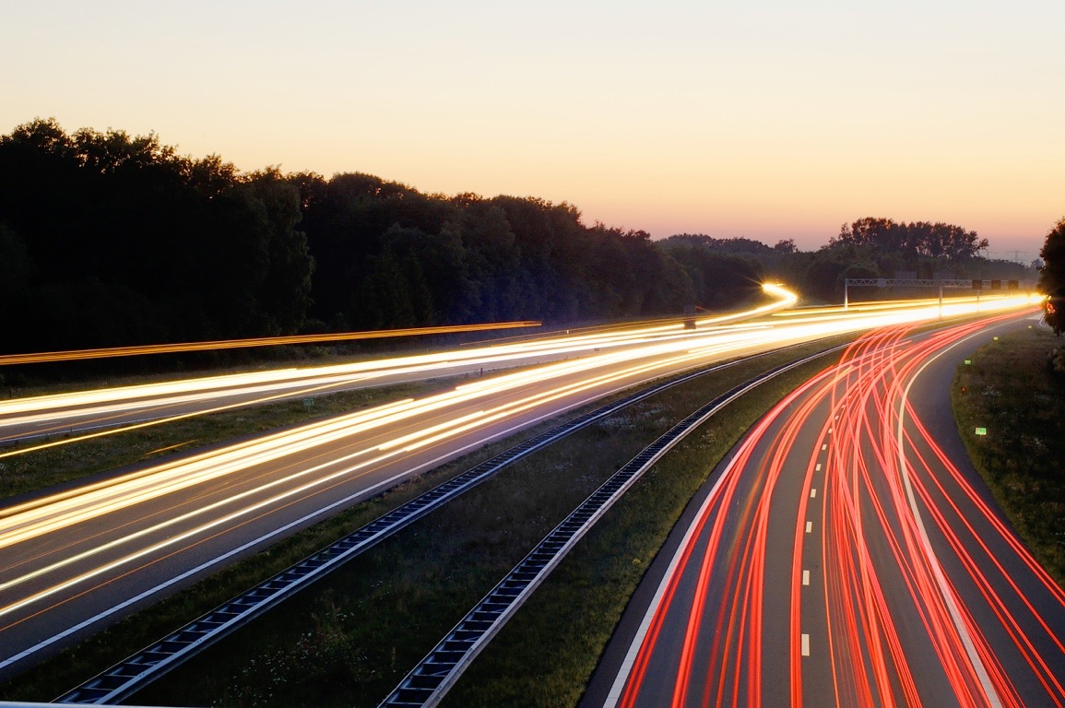
Valuation: Revealed preferences
Principles
Defensive expenditure
Travel costs
Zonal models
Random utility models
Hedonic pricing

Slide 20

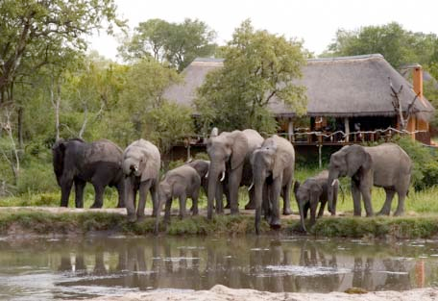

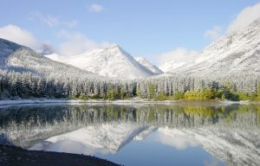
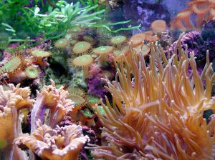

Notes:
TC models are typically used to value use of recreational sites, e.g. …
Again, they give us use values only — as always for RP

Slide 21
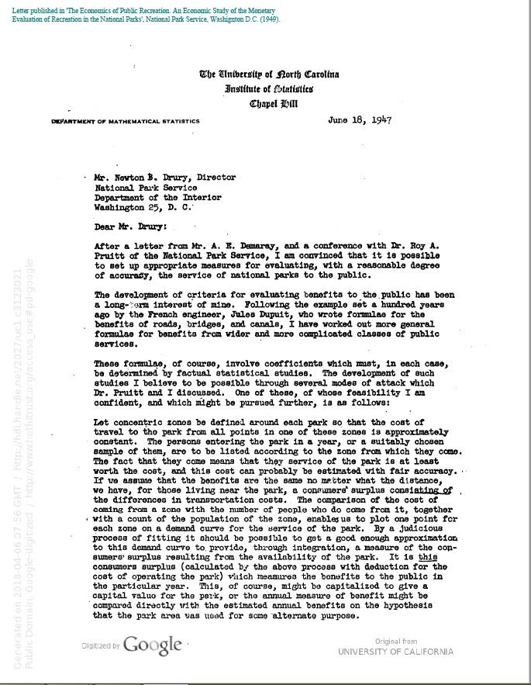
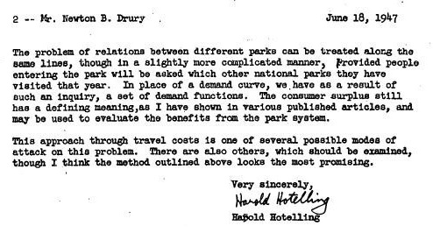
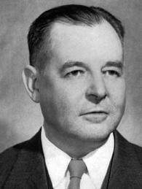
Notes:
TC models were first described in a letter from Harold Hotelling to the director of the US National Parks Service in 1947. (Although not implemented then — everyone else said it was an impossible task, and that’s what they decided!).
Simple intuition. Benefits from visiting a site — even if it’s free — must at least equal the costs of getting there. Otherwise people wouldn’t visit.
People living at different distances from the site face different costs of visiting -> demand curve.

Slide 22

Notes:
TC models were first described in a letter from Harold Hotelling to the director of the US National Parks Service in 1947. (Although not implemented then — everyone else said it was an impossible task, and that’s what they decided!).
Simple intuition. Benefits from visiting a site — even if it’s free — must at least equal the costs of getting there. Otherwise people wouldn’t visit.
People living at different distances from the site face different costs of visiting -> demand curve.

Slide 23
Travel cost models
Applications in valuing …
… opening/closure of a site/sites
… changes in quality of a site/sites
… changes in access costs to a site/sites
Traditional models for a single site
Zonal & individual travel cost
How many trips are made to site X at a particular cost? (continuous decision)
Random utility models for multiple sites
What is the probability of visiting site X rather than Y or Z? (discrete decision)

Slide 24
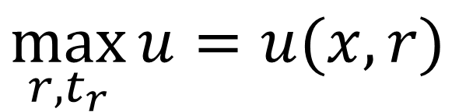
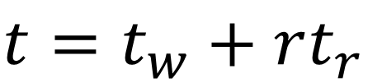
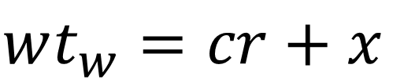
Travel cost: theory
$$\max_{r,t_{r}}{u}=u(x,r)$$
$$wt_{w}=cr+x$$
subject to money budget
and time budget
w — wage rate
t, tr, tw — time
c — direct cost of trip
u — utility
r — visits to recreational site
x — composite commodity
$$t=t_{w}+rt_{r}$$
Notes:
Quick look at the theory. As usual, lots of symbols to say something pretty straightforward.
x, composite commodity = consumption of everything else (measured in money)
maximise u …
subject to two constraints … budget … & time …

Slide 25
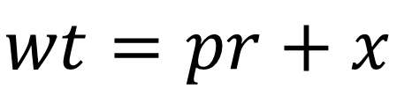
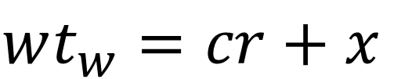
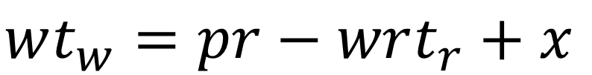
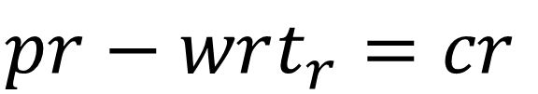
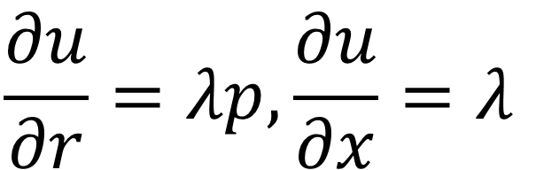
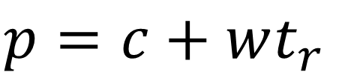
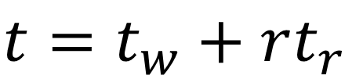
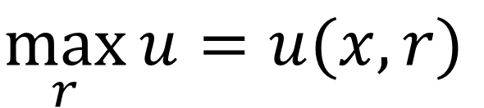
Travel cost: theory
$$wt_{w}=cr+x$$
$$t=t_{w}+rt_{r}$$
p — total cost per trip (including opportunity cost of time)
u — utility
r — visits to recreational site
x — composite commodity
w — wage rate
t, tr, tw — time
c — direct cost of trip
In other words, recreation is a standard consumer good.
$$p=c+wt_{r}$$
$$pr−wrt_{r}=cr$$
$$wt_{w}=pr−wrt_{r}+x$$
$$wt=pr+x$$
$$\max_{r}{u}=u(x,r)$$
$$ℒ=u\left(x,r\right)+λ(wt−pr−x)$$
$$\frac{∂u}{∂r}=λp,\frac{∂u}{∂x}=λ$$
Notes:
One more quantity: the total cost of the trip, including the opportunity cost of time, is p = …
Now if we plug the last two expressions for t and p into the budget constraint, and do some rearranging, we get this alternative formulation for the budget constraint. (Let’s not try too hard to interpret this: it’s just another way of writing the budget constraint, which is about to be useful).
Now we want to maximise utility (u) subject to the budget constraint, so we write the Langrangian for that last formulation, and solve it to give us this optimality condition:
…
where lambda is interpreted as the marginal utility of money
This says that the utility is maximised where the utility gained from the marginal trip = cost of the trip in terms of utility.
Or in monetary terms, I’ll keep taking additional trips to this site
until for the last trip my WTP = the cost of the trip.

Slide 26
£
(£25/trip)
CS
p = £12/trip
WTP
r
(0 trips)
10 trips
Notes:
And that’s here at the red dot on my demand curve.
Backing up a bit, we have r (possible # of trips I could take) along x axis, and money on the y.
We imagine a trip to this particular site always costs me £12 total (including cost of time).
I’m willing to pay £25 for the first trip, a bit less for the second trip, and so on. And I keep making trips up to the point where my WTP is the same as the cost.
And that gives us my welfare measure, the CS,
which is this familiar area
between the constant cost of a trip and my demand curve.
(r is actually discrete, but let’s not worry about that right now.)
To calculate my CS we need to know the demand curve as in this diagram.
But, in practice, for an individual, we only get to observe the red dot, not the line: we see how many trips I make and how much a trip costs me, but we don’t observe how many trips I would make if the cost was different.

Slide 27
Zonal travel cost model: setup
Zones:
Site
1
2
3
…
Notes:
For that, we need to build a model.
And the original and simplest TC model is the zonal model.
We’ll walk through a basic example of a ZTC model.
First: take a site. Define a series of zones around the site.

Slide 28
Zonal travel cost model: data
Zone i | Visits vi | Pop. ni | Travel cost ci | Rate r_{i} (per 1,000)
1 | 15,000 | 2m | £10 | 7.5
2 | 48,000 | 8m | £15 | 6.0
3 | 11,250 | 2.5m | £20 | 4.5
4 | 45,000 | 15m | £25 | 3.0
5 | 34,000 | 22.66m | £30 | 1.5
Visit rate ri = vi / ni
Linear model, OLS ri = 10.5 – 0.3ci
Ordinary least squares minimizes the squared distance between the observed value and the predicted values
Notes:
Next, gather data
First 3 columns by survey
[click]
Then, estimate travel costs
e.g. £1/mile and use the round trip distance from the zone to the site
Then model how the number of trips we observe depends on price … [click …] …

Slide 29
Zonal travel cost model: admission fee
Zone i | Visits vi | Pop. ni | Travel cost ci | ci + a | ri (per 1,000) | Predictedvisits ri × ni
1 | 15,000 | 2m | £10 | £15 | 6 | 12,000
2 | 48,000 | 8m | £15 | £20 | 4.5 | 36,000
3 | 11,250 | 2.5m | £20 | £25 | 3 | 7,500
4 | 45,000 | 15m | £25 | £30 | 1.5 | 22,500
5 | 34,000 | 22.66m | £30 | £35 | 0 | 0
Imagine we charged an admission fee a
ri = 10.5 – 0.3(ci + a)
Plug in different values of a (see above for a = 5)
Notes:
Now, we have people in different zones making trip decisions based on a range of prices. That’s great, because it gives us a model of how people react to price in this situation.
But to estimate the total demand curve for the site we need to estimate how the total population would react to different prices.
So now we imagine that we’re going to impose an admission fee for the site. [click]
We assume people react to this the same way they react to travel costs — so we can extend our model to predict new visitation rates from all zones. [click]
Then we pick different values for a, and see how our predicted visits respond. [click]
E.g. for a = 5, we predict 78,000 visits

Slide 30
Zonal travel cost model: results
Hypothetical admission fee a | Estimated total visits for all zones
0 | 153,250 (actual)
£5 | 78,000
£10 | 36,750
£15 | 18,000
£20 | 3,000
£25 | 0
Notes:
For different values of a we get these predicted visits:
0 (actual) -> current actual visits
£5 -> as just seen
£10 etc.
£25 -> no visits: implies nobody gets more than £25 of consumer surplus even from their first visit

Slide 31
ci + a
CS = £1,061,875
a = £25
CS
a = £0
r
r = 0
r = 153,250
Notes:
If we plot that, you can see the outline of a demand curve appearing.
And as I showed before, we want the area under that — which we can work out as the sum of the areas of these squares and triangles.
This example is in the Perman et al textbook (in the library) if you want to see the calculation.

Slide 32
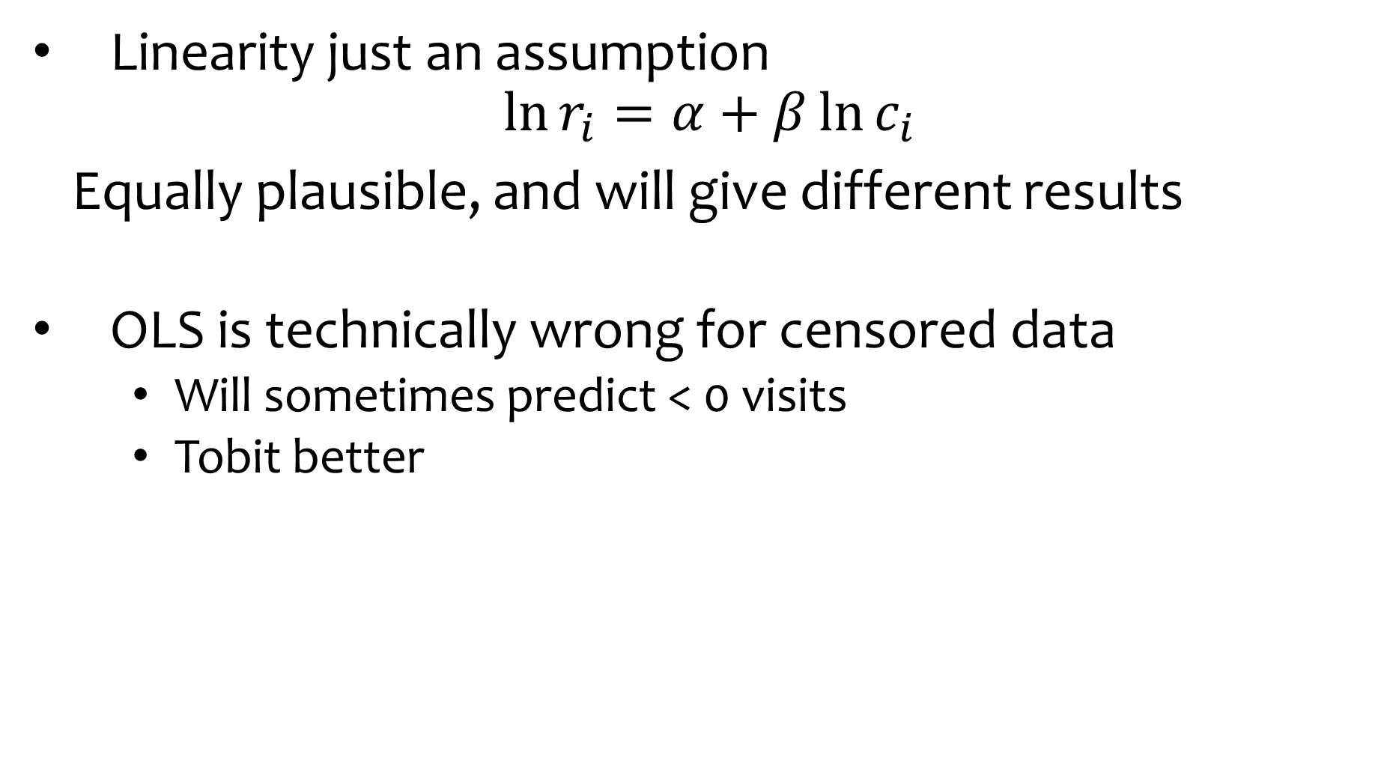
Zonal travel cost model: notes
Linearity just an assumption
$$\ln{r_{i}=α+β\ln{c_{i}}}$$
Equally plausible, and will give different results
OLS is technically wrong for censored data
Will sometimes predict < 0 visits
Tobit better
Notes:
Two things to bear in mind about this simple model.

Slide 33
Individual travel cost model
Individual-level data
Calculate shortest actual travel distance from home to site and substitutes using GIS
Include socio-economic characteristics in model — e.g. income, age, gender
Notes:
A refinement of the zonal model is the individual model

Slide 34
Traditional travel cost limitations
Demand curve ought to specify prices of all substitute sites too
More/better substitutes means lower value
Not always adequately addressed
Site quality
Multi-purpose trips
Quality of trip
Opportunity cost of time
Non-use values
Notes:
Multi-purpose trips: similar problem to joint products in defensive expenditure models
Opportunity cost of time spent travelling. We valued it at the wage rate. Implies that every hour you’re travelling is an hour you would otherwise have been working, and that’s how you value your time.
This is a bit odd. It assumes the only difference in utility between work and travel comes from the wages we do or don’t earn — and that we can all freely choose how many hours to work.
So instead, a common convention is to use 1/3 the wage rate. But not especially robust. Treatment of travel time can make a big difference in valuation. (Even worse, travel time can be work time — one important criticism of the CBA done for HS2 train line is this was ignored).

Slide 35

Valuation: Revealed preferences
Principles
Defensive expenditure
Travel costs
Zonal models
Random utility models
Hedonic pricing

Slide 36
Random utility model (RUM) limitations
Demand curve ought to specify prices of all substitute sites too
More/better substitutes means lower value
Not always adequately addressed
Site quality
Multi-purpose trips
Quality of trip
Opportunity cost of time
Non-use values
Notes:
What limitations does it solve?
RUM designed to deal with questions of substitutes and variations in site quality

Slide 37
Model of discrete choice between sites
We observe that individual i chooses to visit site g out of j = 1, 2, … , J
So uig ≥ uij for all j ≠ g
Tastes vary
So decompose u into a deterministic part v and stochastic (or random) part ε
vig + εig ≥ vij + εij for all j ≠ g
Notes:
RUM is a model of discrete choice between sites.
In other words, …
…

Slide 38
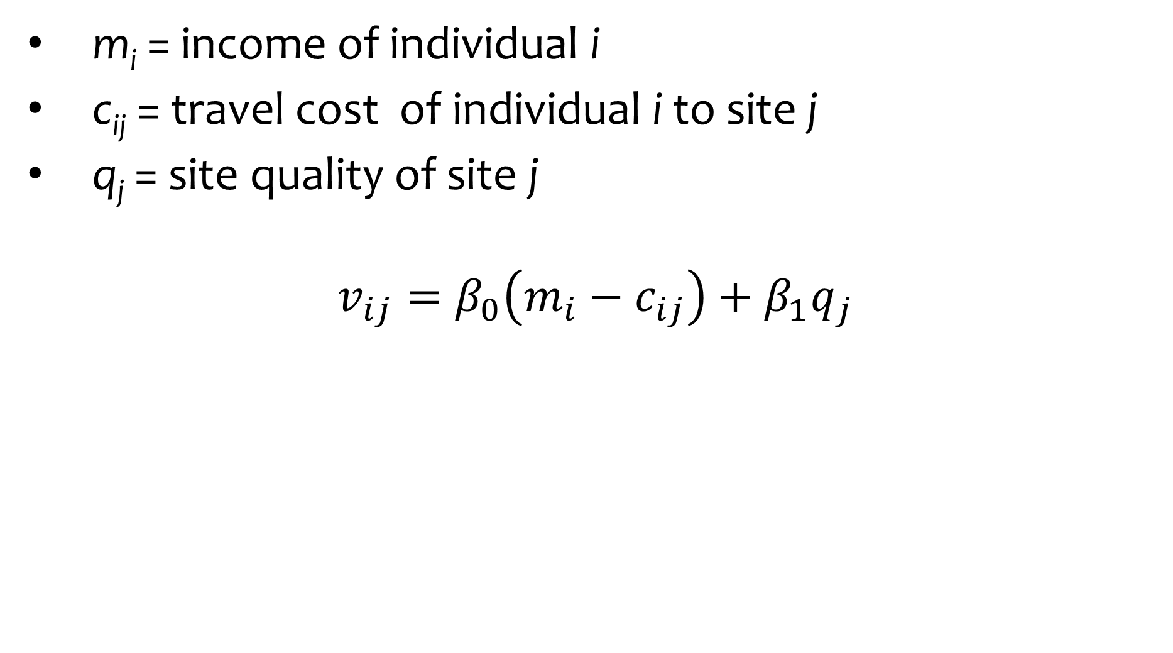
vij — utility as a linear function of …
m_{i} = income of individual i
c_{ij} = travel cost of individual i to site j
q_{j} = site quality of site j
$$v_{ij}=β_{0}\left(m_{i}−c_{ij}\right)+β_{1}q_{j}$$
Notes:
Deterministic part v is modelled as follows …
…
In practice there will generally be several q parameters in the model, representing different site characteristics
And assume a distribution for the random part, epsilon

Slide 39
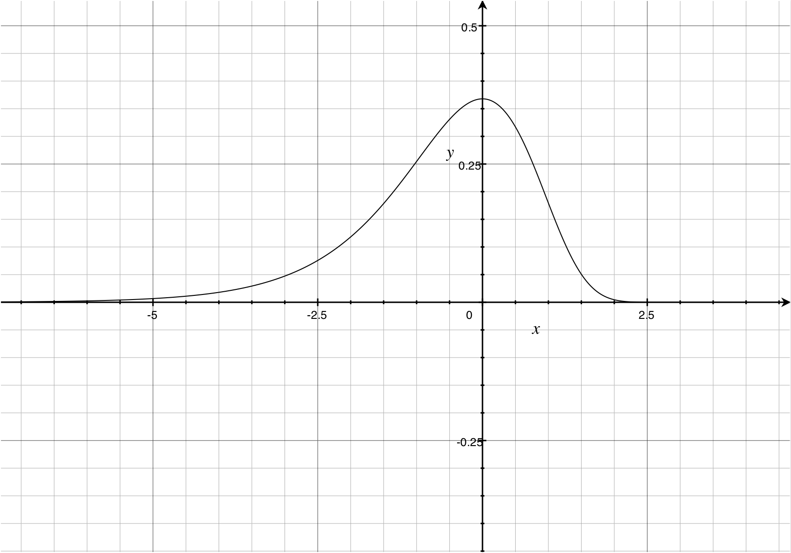
εij — assume Gumbel distribution
Notes:
Specifically, this distribution, the Gumbel or Type I Extreme Value distribution
Why, because it makes the next step super-simple

Slide 40
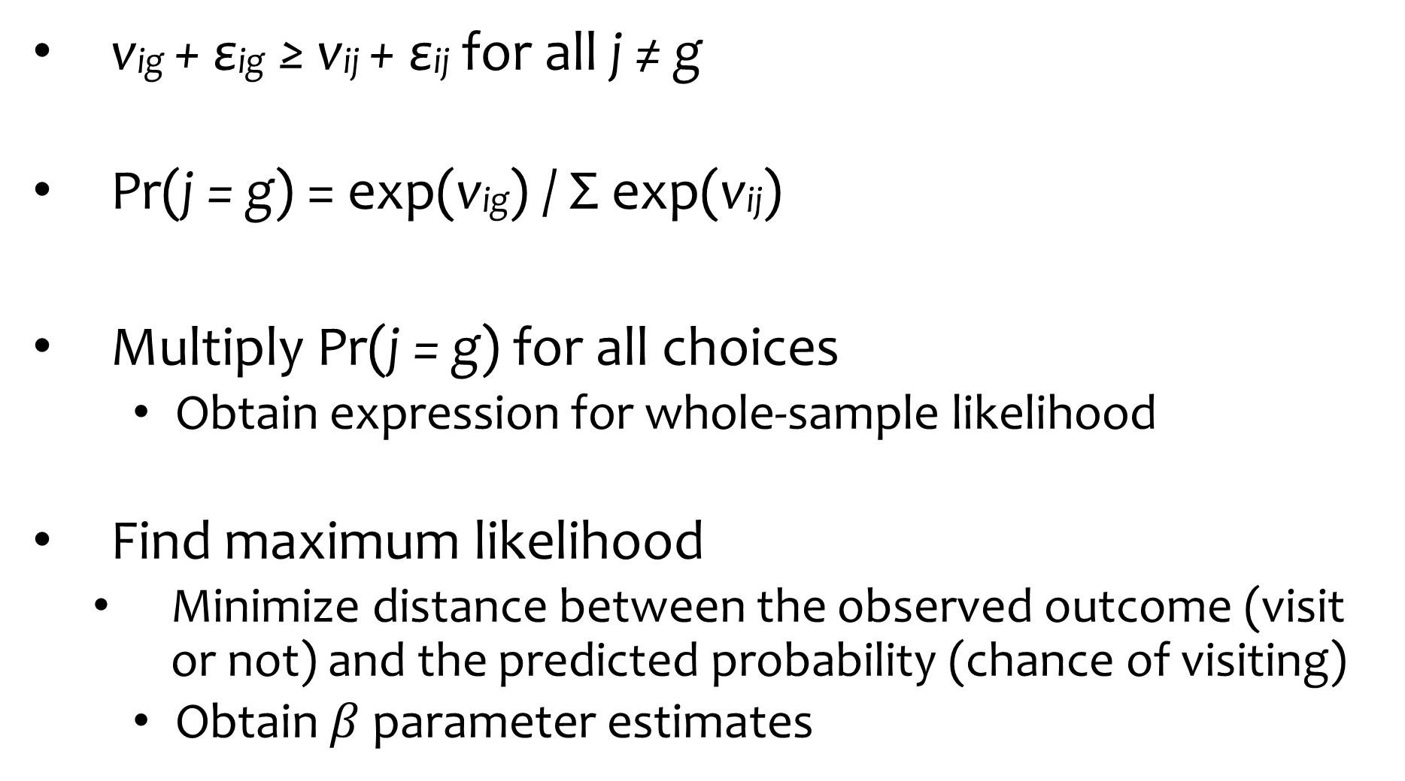
Estimate with conditional logit
vig + εig ≥ vij + εij for all j ≠ g
Pr(j = g) = exp(vig) / Σ exp(vij)
Multiply Pr(j = g) for all choices
Obtain expression for whole-sample likelihood
Find maximum likelihood
Minimize distance between the observed outcome (visit or not) and the predicted probability (chance of visiting)
Obtain $β$ parameter estimates
J
j = 1
Notes:
If the error terms are distributed this way, then the probability that an individual will choose site g is given by this formula … .
And since we observe lots of people’s choices we can multiply the probability of each choice, calculated this way, to give us the whole sample likelihood.
Then we maximise this likelihood to find estimates of the β parameters in our model of v. (Note: this is called a conditional logit, and is built in to Stata and other stats programs).
This is also the model we use to analyse choice modelling data.

Slide 41
Calculate Consumer Surplus
For changes in q
For adding a site
For removing a site
Total number of trips is not explained
May need to be modelled separately
Independence from Irrelevant Alternatives assumed
The relative probabilities of visiting Wakehurst or Sheffield Park are independent of whether you know about Standen
Notes:
…
Newer studies use more complex models — RPL, aka mixed logit — to relax this assumption.

Slide 42

Case study 2:
game park visits
Notes:
TC (RUM) case study

Slide 43
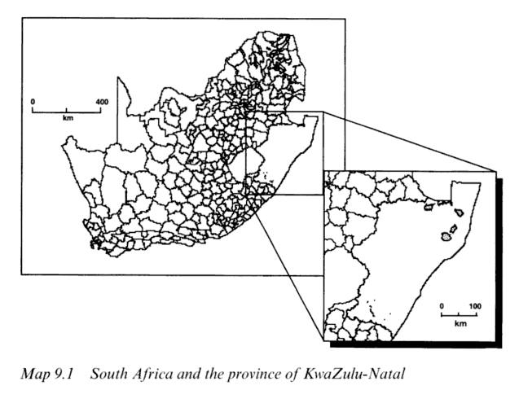
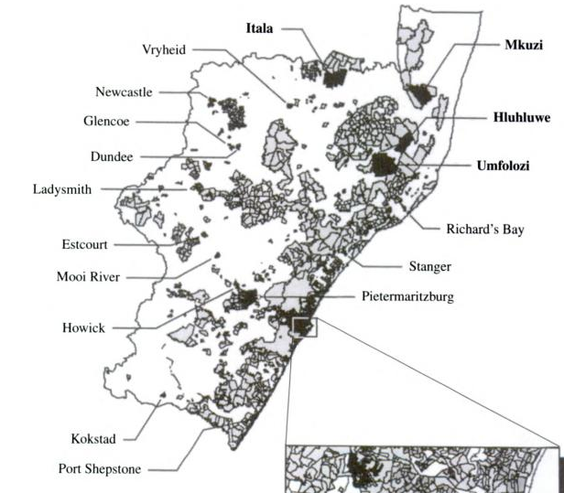
Travel cost case study: background
Game park visits in KwaZulu Natal, South Africa
Day et al., 2002
4 parks
Best wildlife at dawn and dusk, and parks are remote, so most visitors stay 1 or more nights
Various accommodation options

Slide 44
Travel cost case study: questions
?
How much welfare is derived from access to parks?
How might this change with different management decisions?
How will revenues change in response to changes in pricing?
Entry fees, accommodation costs
Notes:
NB. TC is broader set of costs than purely travel — it’s all the market costs associated with visiting the site

Slide 45
Travel cost case study: preparation
Identify choice set
Umfolozi, Hluhluwe, Mkuzi, Itala
Quality differentiation: species and accommodation
Identify users
Local residents
Collect data on visits
Parks board had details of 26,000 bookings in 1994 – 95
Sampled 1,000

Slide 46
Travel cost case study: data
Individual data
Address, party size, accommodation type, visit duration, park visited, entry fee, accommodation fee
GIS used to …
… locate home, as assumed trip origin
… match with neighbourhood socio-economic data

Slide 47
Travel cost case study: trip costs
Travel cost
Calculate door-to-gate road distances for each household to each reserve
Speed and fuel consumption assumptions according to road types
+ Entrance fees
+ Accommodation cost
+ Cost of time travelling & in park
Different wage multiples inferred from data: 1.49 & 0.34
Wage based on average income for individual’s neighbourhood

Slide 48
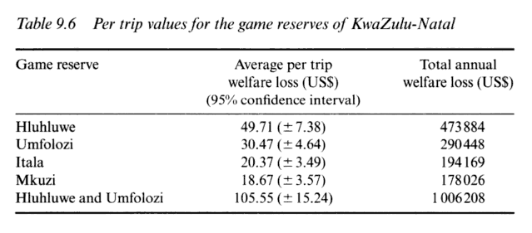
Welfare estimates: closing parks
Notes:
Results! (Closing parks).
Range per trip: $20 – 50 per single park.
Last line is predicted loss if closing two neighbouring parks near the capital city.
Losses are more-than-additive because of loss of substitution possibilities.

Slide 49
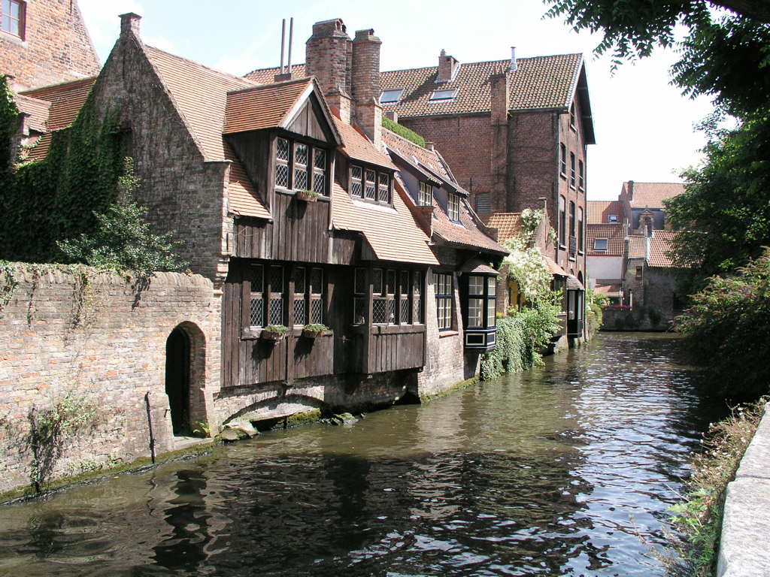
Valuation: Revealed preferences
Principles
Defensive expenditure
Travel costs
Zonal models
Random utility models
Hedonic pricing

Slide 50
Hedonic pricing: basics
Assume price of a market good (e.g. house) is a function of its characteristics …
… including environmental quality characteristics h = h(q1, q2, …, qn) + ε
Value of an environmental good ≈ price differential it induces between otherwise-identical houses
bedrooms
aircraft noise
water amenities
bathrooms
£
=
original features
air quality
green spaces
parking
local schools

Slide 51
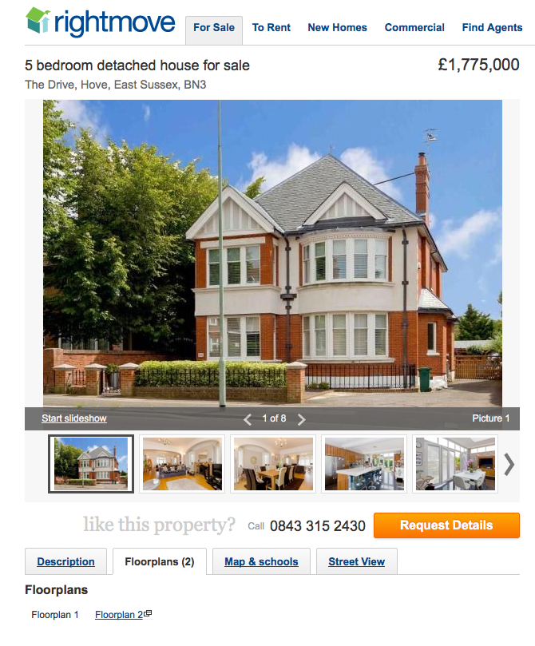
Hedonic pricing: regression models
LHS: sale price
RHS
Environmental
Noise; air quality; water quality of nearby lake; scenic views; …
Structural
floor area; # rooms; # bathrooms; # garages; size of garden; heating type; …
Accessibility (GIS)
Distance to: bus stop; town centre; shopping centre; …
Neighbourhood
Average age; crime rate; school quality; …
Market conditions
Year and month of sale; …
Notes:
Now, we don’t have generally have otherwise-identical houses that vary only in one EQ characteristic
But we do have multiple regression techniques, which should allow us to control for the other characteristics that vary.
So we estimate a regression model with, on the LHS, …

Slide 52
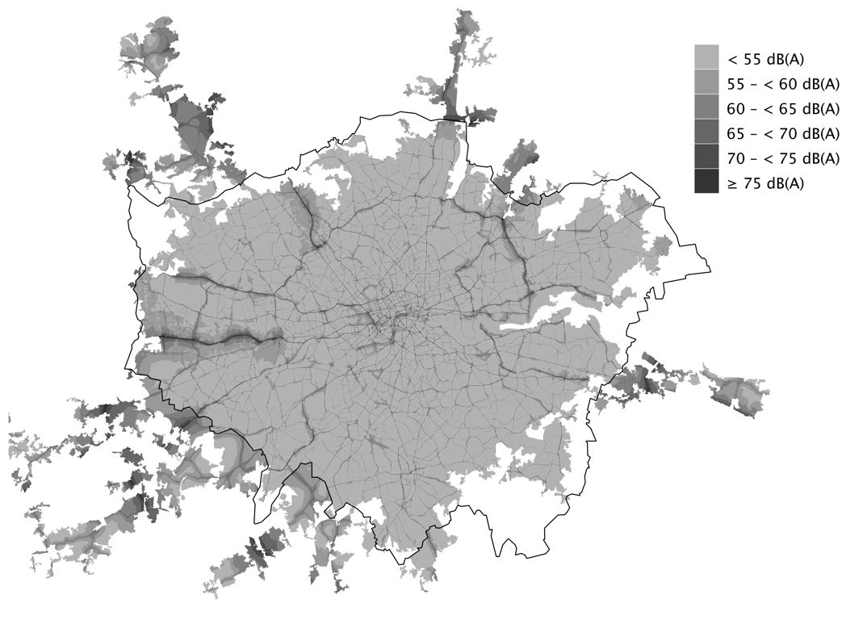
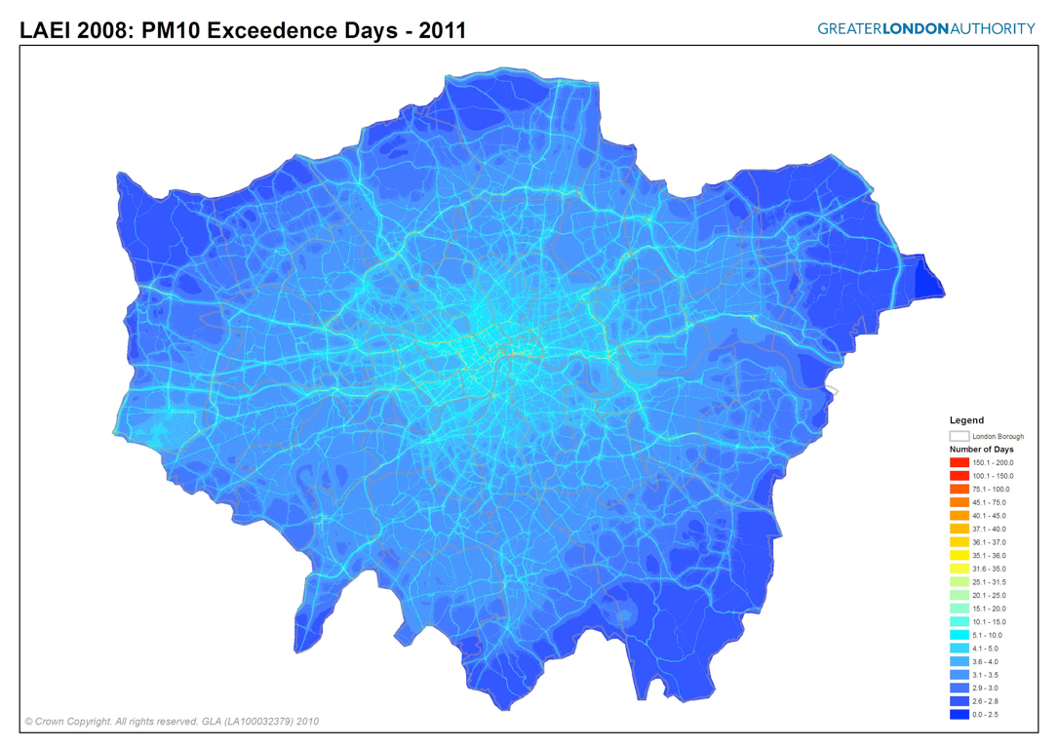
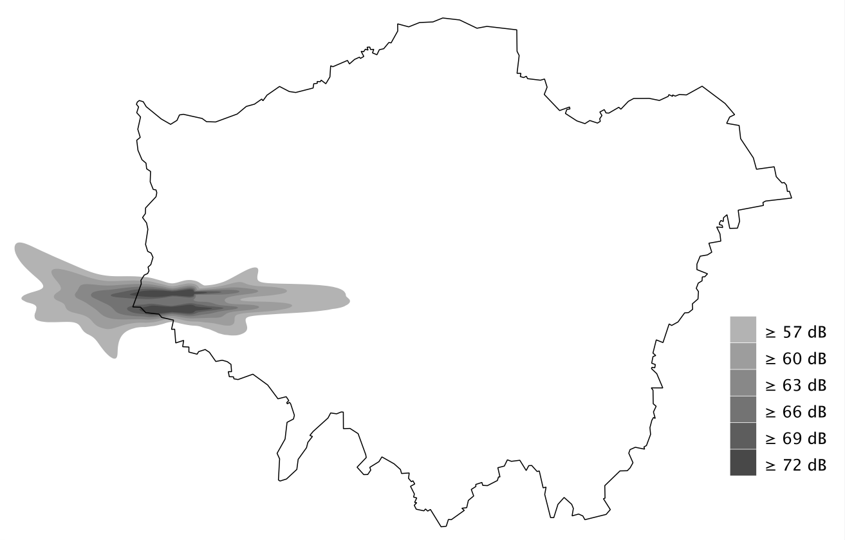
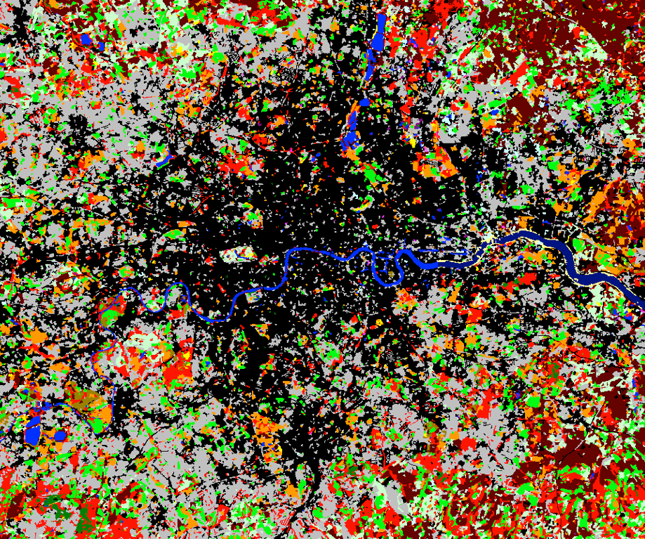
Hedonic pricing: use of GIS data
Notes:
For accessibility, neighbourhood and environmental data: GIS
Data for London used in own research

Slide 53
Hedonic pricing: two stages of analysis
Estimate hedonic price function
Can recover implicit price of characteristics — i.e. marginal WTP
Reasonable data requirements
Widespread application
Estimate demand curves for characteristics
Can calculate welfare benefit of non-marginal quality changes by integrating demand curves
Complex modelling and heftier data requirements (e.g. in different cities or periods)
Not often undertaken

Slide 54
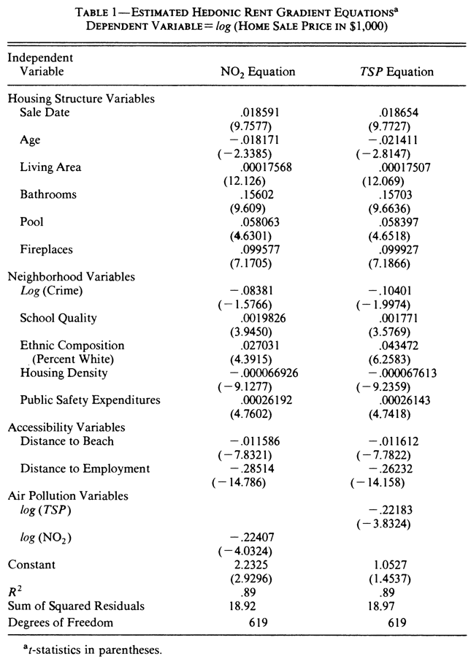
Hedonic pricing: price function
ln(h) = 2.23 + 0.16·bathrms + 0.10·fireplaces – 0.01·beachdist – 0.22·ln(NO2) + …
Notes:
Example from a hedonic pricing study in the US.
…
Implicit prices here complicated by using log of house price:
but for example being 1 mile closer to the beach is worth $ e^0.011 (= approx $1000) on house price on average.
And (environmental point): two measures of air pollution have a negative impact.

Slide 55
Hedonic pricing: assumptions
Single, perfect, competitive property market
Perfect information
No transaction costs
Immediate equilibration
That’s why there are no characteristics of the buyer and the seller
Correct functional forms

Slide 56
Hedonic pricing: strengths
Property records usually available and reliable
Property markets generally responsive

Slide 57
Hedonic pricing: weaknesses
Scope limited to things that affect house prices
People must be aware of environmental characteristics, and able to predict their impacts, when choosing a house
The environment does not just affect house prices, it affects wages too
Wages affect house prices, and house prices affect wages

Slide 58
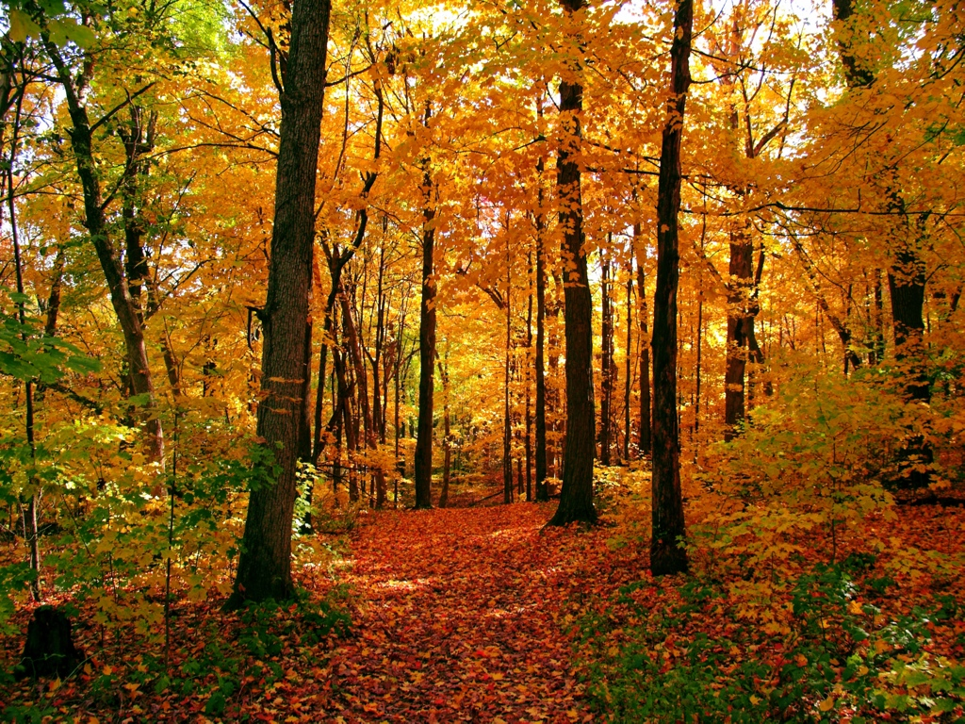
Case study 3:
the amenity value
of English nature

Slide 59
Hedonic pricing case study: question
What is the value of living in or near desirable natural areas?
Gibbons et al., 2011
Contribution to UK National Ecosystem Assessment
Variety of use values
Visual amenity
Sports
Cultural heritage
Health
Leisure, recreation, tourism
Education
Inspiration, psychological benefits

Slide 60
Hedonic pricing case study: data
1m housing transactions
Nationwide mortgages, 1996 – 2008
Incl. full postcode
House characteristics
Neighbourhood variables
Environmental variables
Proximity and amount

Slide 61
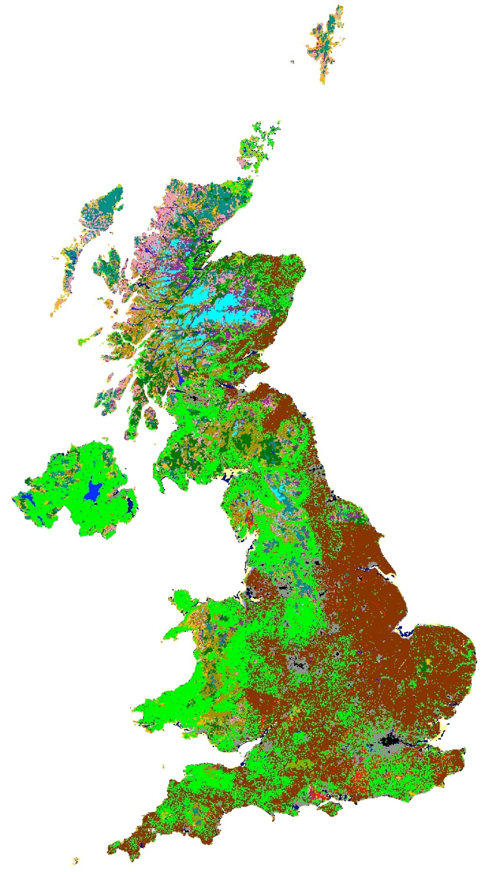
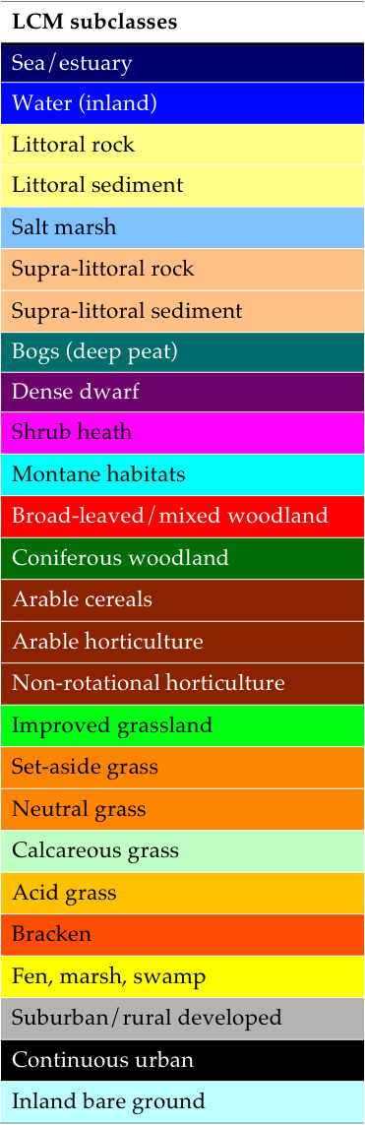
Hedonic pricing case study: habitat

Slide 62
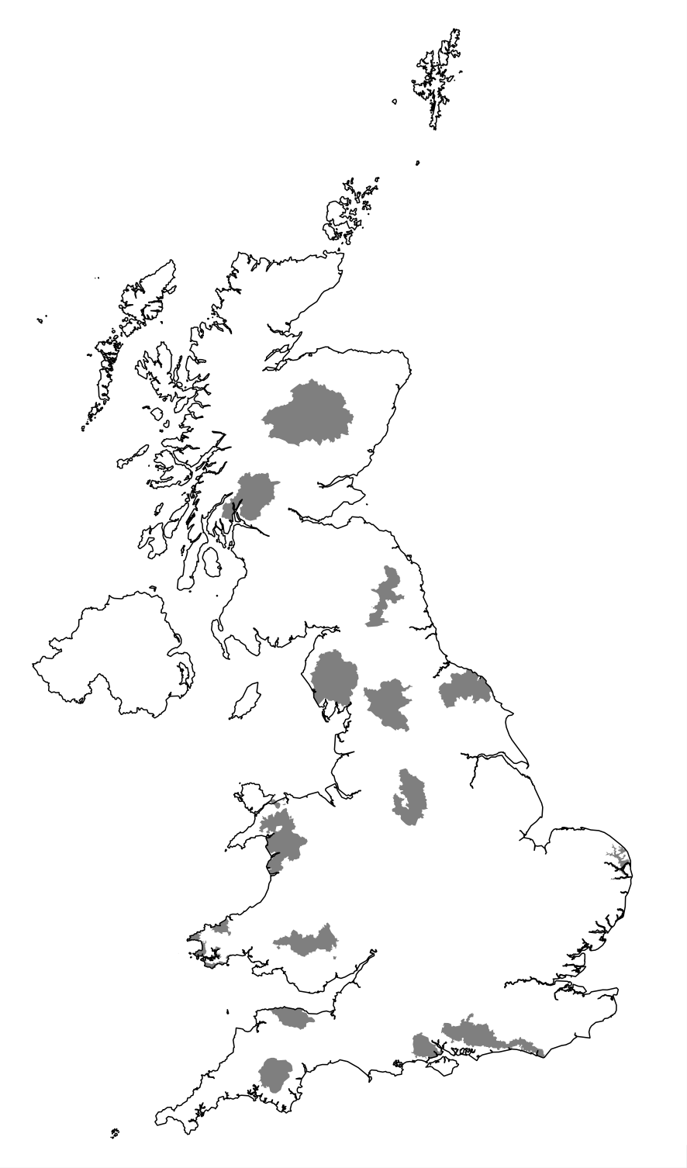
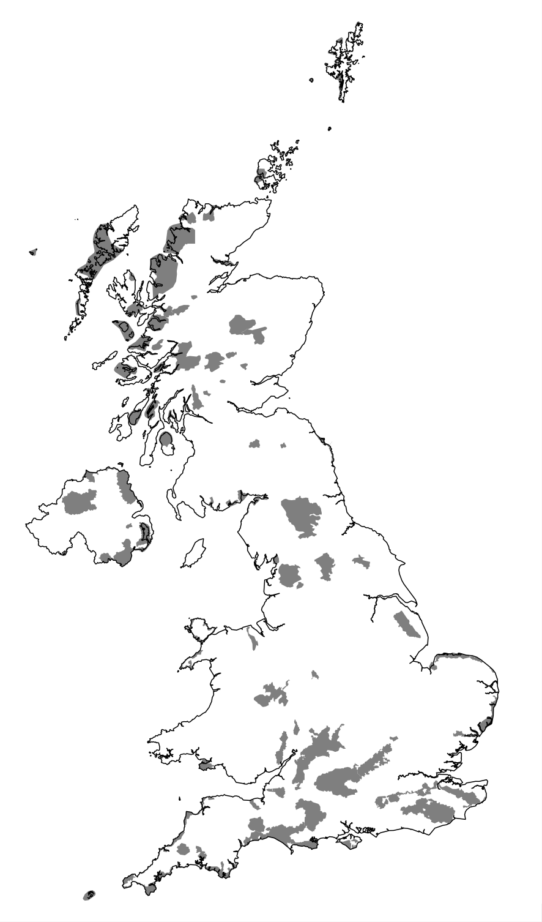
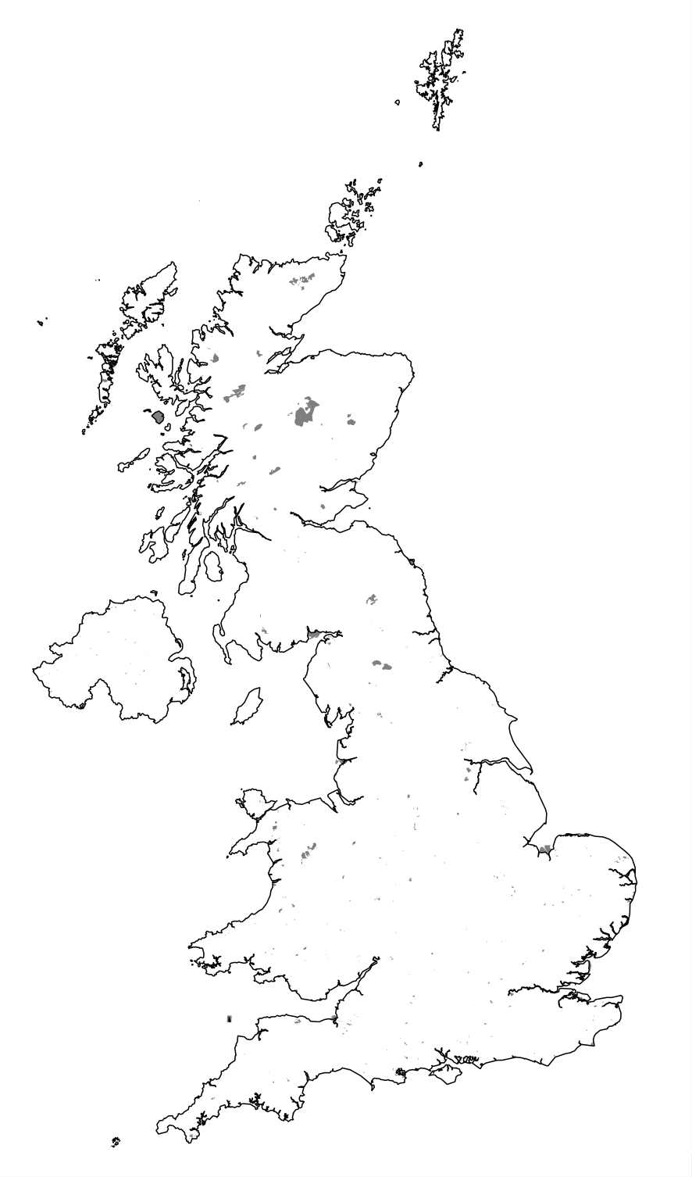
Hedonic pricing case study: designation
National parks Green Belt National Trust
Notes:
Nat parks, AONBs, NNRs

Slide 63
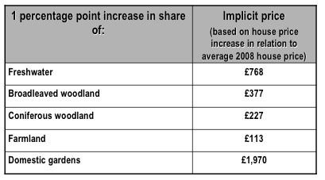
Implicit prices: habitats
Notes:
In 1km square
Baseline: urban

Slide 64
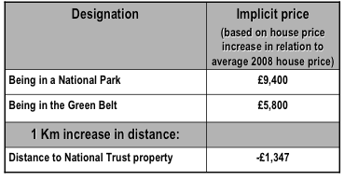
Implicit prices: designation

Slide 65

Environmental value
Dark green = highest values of environmental amenities
> £67,000 on average house price
Lake District, Northumberland, North York Moors, Pennines, Exmoor, Dartmoor
Dark red = lowest levels
Somewhere near Northampton

Slide 66
Revealed preference: summary
Method | Behaviour | Link from market to non-market good | Applications
Defensive expenditure | Purchases + time spent to avoid harm | Substitute goods | Health: mortality, morbidity
Travel cost | Visit to recreational site | Complementary goods | Recreational demand
Hedonic pricing | Property purchase; job choice | Bundled goods | Environmental (dis)amenities; mortality risks
Notes:
In summary, …

